Slide 1

Join Our Family
SOUTHERN REALTY
ENTERPRISES,INC

Slide 2

Training Training Training
FAST TRACK PROGRAM
NEW ASSOCIATE TRAINING
ADVANCED CLASSES
FIELD TRAINING PROGRAM
COMPUTER CLASSES
BOARD TRAINING
VIDEO & DVD LIBRARY
PERSONAL WEB SITE EDITING
TECHNOLOGY TRAINING
24/7 ON LINE TRAINING

Slide 3

Broker Price Opinions
ACCURATE & PROFESSIONAL CMAS
TOTALLY COMPUTERIZED WITH MAPPING

Slide 4

Major Corporations use our services
AT&T
WESTINGHOUSE
SUNTRUST
NORTHROP GRUMMAN
WACHOVIA
AAA
FEDERAL EXPRESS
GENERAL FOODS
LOCKHEED MARTIN
GENERAL ELECTRIC
MANY MORE

Slide 5

We sell for the US Government
VA - VETERANS ADMINISTRATION
FANNIE MAE & FREDDIE MAC
HUD-FHA - FEDERAL HOUSING AUTHORITY

Slide 6
Worldwide Marketing
WE BRING YOU MORE BUYERS
INTERNATIONAL MLS
WORLDWIDE BROKER NETWORK
INTERNET BUYERS & SELLERS
LISTED ON OVER 100 WEB SITES
OVER 1000 REFERRALS PER YEAR

Slide 7
Quality Flyers
Full color flyers
Personal Brochures
Company brochures
Full color laser printer

Slide 8
Top Services
"OPTIONAL" - WEEKEND FLOOR TIME
CLOSED FLOOR SYSTEM
GROUP ADVERTISING PROGRAMS
BEAUTIFUL OFFICE - GREAT LOCATION
NEW AGENTS AVAILABLE FOR OPEN HOUSES,ETC.
QUALITY FULL COLOR MARKETING MATERIALS
SALES CONTESTS,RECOGNITION AND AWARDS
GREAT HEALTH AND DENTAL INSURANCE AVAILABLE
LOCAL AND NATIONAL DEMOGRAPHICS AND INFO
DIGITAL CAMERA FOR INSTANT PHOTOS & FLIERS

Slide 9
More Services for You
QUALITY SECRETARIAL SERVICES
LASER FAX MACHINE ( fax broadcasting )
FREE VOICE MAIL
MLS High Speed access
FREE TRAINING
FREE ERRORS & OMMISSIONS INSURANCE
REIMBURSEMENT PROGRAM - GRI & CRS
INVESTOR PROPERTY LISTS
SELLER'S ASSISTANCE PROGRAM
SELLER'S HOME IMPROVEMENT
TRADE-IN PROGRAM

Slide 10

Variable Rate Commissions
GET MORE LISTINGS
WITH OUR VARIABLE RATE COMMISSION PROGRAMS !

Slide 11
Get More Buyers and Sellers
Our Exclusive Buyers and Sellers Benefits Pkgs
FREE Home Security System
Wholesale Pricing on Flooring,Cabinets and Countertops
New Appliances and Big Discounts
Save on Moving Costs
FREE Consultation with Interior Designer
Discounts on Furniture and more
Vendors and Service companies with discounted rates

Slide 12

We Get the Job Done
SALES RATE
OUR AVG. IS 95 %
MLS ONLY 73 %
BASED ON 2020 ORLANDO BOARD OF REALTORS STATISTICS

Slide 13
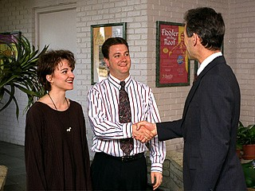
Our Mortgage Affiliations
BENEFITS TO YOU
MORE QUALIFIED BUYERS
BETTER SERVICE
MORE LOAN APPROVALS
FLYERS,BROKER OPEN HOUSES
NO POINT LOANS

Slide 14

Our Title Companies
BENEFITS TO YOU
BETTER SERVICE
FASTER CLOSINGS
ADDT'L INCOME FROM OWNERSHIP

Slide 15

Free Short Sale Processing
Make More Income by Listing and Selling Short Sales
We have companies to process your Short Sales with no cost to you or your Seller or the Buyer

Slide 16

Great Advertising
ORLANDO SENTINEL
HOMES & LAND
TREASURE CHEST
WALL STREET
NEW YORK TIMES
DIRECT MAIL OUTS
UNIQUE HOMES MAGAZINE
LA PRENSA
OUT OF STATE PUBLICATIONS
MANY MORE

Slide 17
High Tech Advertising
RADIO ADVERTISING
We bring more buyers with our
" TALKING HOUSES "
DREAM LINE
Buyers love calling our "Dream Line" to
obtain information on our listings 24 hours
a day 7 days a week

Slide 18
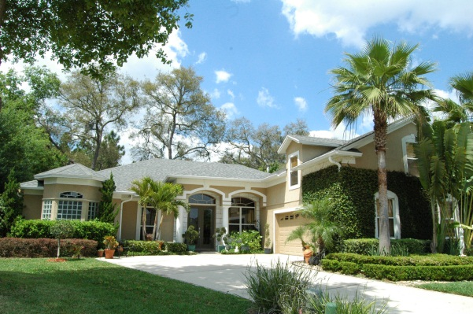
Upscale Home Marketing
UNIQUE HOMES MAGAZINE
DISTRIBUTED WORLDWIDE
FORTUNE 500 EXECUTIVES
ROLLS ROYCE OWNERS
FIRST CLASS AIRLINE SECTIONS
MANY MORE LOCATIONS

Slide 19
Direct Mail Marketing
FULL COLOR POSTCARDS
JUST LISTED - JUST SOLD PROGRAMS
BULK PERMITS
BUSINESS REPLY PERMITS
COMPUTER DATABASES FOR DOCTORS,LAWYERS,ACCOUNTANTS,BUILDERS,REALTORS,SUBDIVISIONS & MORE

Slide 20

DVD’s for Marketing
OTHER CITIES IN THE U.S.
FOR FSBO'S
PREPARING YOUR HOUSE TO SELL
PRICING YOUR HOUSE PROPERLY
PICKING THE RIGHT REALTOR
LISTING EXPIRED ? FIND OUT WHY

Slide 21

High Commission Splits
TOP COMMISSIONS - YOUR CHOICE
100 % SPLITS from $ 0 /mo. if 2 closings or more in previous month
75-90 % NO MONTHLY FEES Sm Annual Fee
50-80% NO MONTHLY FEES

Slide 22
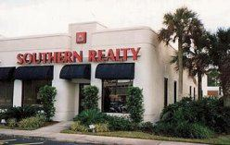

Let’s Get Started Now
SOUTHERN REALTY
ENTERPRISES,INC.
407-869-0033
1-800-771-0031
FRANK FILIPPELLI , PRES.
Florida-Houses.com

